Slide 1








Retail Dynamics – Exploring Sales
An end-to-end analytical workflow turning raw retail data into governed Ontology models, deep investigative analytics, and executive business applications.

Slide 2
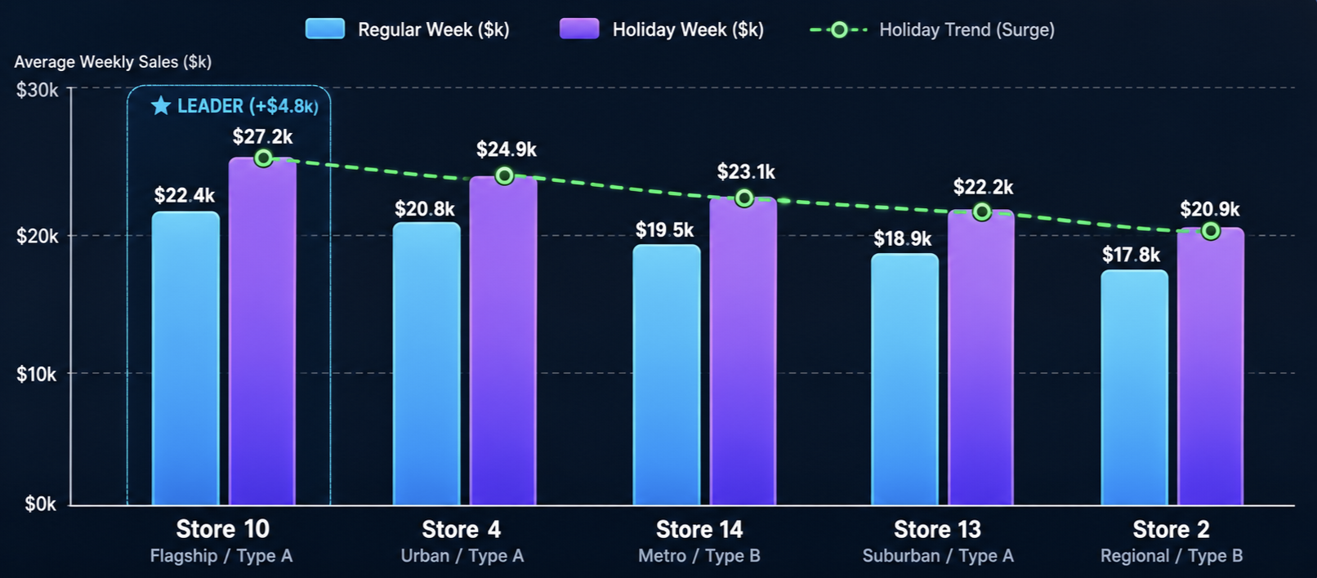


Case Study Overview
Primary Objective: Build a governed sales analytics pipeline to explore store performance and deliver actionable retail decision intelligence.
Analytical Foundation
Powered by Stores, Features, and Sales datasets structured for high-performance downstream querying.
Exploration & Visualization
Quiver for multi-dimensional deep dives and Contour for interactive time-series dashboards.
Final Business Delivery
A unified Foundry Workshop web app for operational decision makers.

Slide 3






1. Data Ingestion & Preparation
Sales Dataset
Stores Dataset
Features Dataset
Primary fact table containing granular historical retail transactions across store departments.
Store-level dimension table providing operational attributes and categorization.
Contextual dataset supplying external economic and environmental market drivers.
•
Store identification numbers
•
Regional temperature records
•
Weekly sales records
•
Store type classifications (A, B, C)
•
Fuel price fluctuations
•
Store ID & Department keys
•
Store physical size metrics
•
Promotional markdowns (1 to 5)
•
Date & holiday indicators

Slide 4



2. Pipeline Creation & Transformation
Source Dataset | Transformation Stage | Cleansed Output | Target Ontology Object
Sales (Raw) | Data profiling, type alignment, null checks | Sales_cleansed | CleansedSales_Obj_CS
Stores (Raw) | Attribute validation, deduplication | Stores_cleansed | CleansedStores_Obj_CS
Features (Raw) | Missing value imputation, column cleanup | Features_cleansed | CleansedFeature_Obj_CS
All pipelines established standardized data types, removed unwanted artifacts, and ensured reliable lineage before semantic publication.

Slide 5


3. Ontology & Business Modeling
Semantic Object Layer
Relational Linking
Transforming Raw Data into Real-World Concepts:
Connected Enterprise Intelligence:
• Cleansed Sales Object: Captures transactional performance with Store ID, Date, Department, and Weekly Sales.
• Primary Keys & Titles: Defined unique identifiers to ensure deterministic object resolution across systems.
• Cleansed Stores Object: Enriches sales metrics with store type and capacity parameters for group comparisons.
• Cross-Object Links: Connected Sales to Stores and Features via compound keys (Store ID + Date).
• Cleansed Features Object: Integrates macroeconomic variables like temperature, CPI, and fuel pricing.
• Governed Access: Enables analysts to query business entities directly without writing complex SQL joins.

Slide 6







4. Exploratory Analysis in Quiver
1. Top 5 Stores
2. Type vs Fuel
3. Holiday Impact
4. Temp vs Sales
Identified stores exhibiting the highest average Weekly Sales across all reporting periods.
Analyzed relationship between store classification types and regional fuel price variations.
Evaluated departmental revenue spikes during standard weeks versus designated holiday periods.
Assessed sensitivity of sales volumes against regional temperature shifts and weather cycles.
Key Finding: Dynamic Quiver Canvas analysis highlighted Store 10 as the consistently highest-performing retail location across configured sales metrics.

Slide 7


5. Visual Intelligence in Contour
Interactive Visual Dashboards
Embedded Exploration Layer
• Built comprehensive charts visualizing longitudinal weekly sales trajectories and seasonal peaks.
• Designed to support continuous ad-hoc exploration rather than rigid, static reporting formats.
• Formulated comparative store performance views contextualized against markdown and economic drivers.
• Provides multi-dimensional slicing across store format, timeline, and holiday status.
• Serves as the interactive visualization core embedded into the downstream Workshop application.
• Transformed raw datasets into polished, business-ready analytical visual paths.

Slide 8





6. Workshop Application
Store
20
Operational Workshop Features
Interactive Filters
• Dynamic Filtering: Instant slice-and-dice by Store ID, Date Range, and Holiday Flag.
Top Performing Store
• Executive KPI Cards: Real-time visibility into Total Sales and Average Weekly Sales.
• Guided Drill-Downs: Allows end-users to move seamlessly from macro metrics to departmental roots.
• Published & Governed: Fully validated, permissioned, and deployed for business stakeholders.
Embedded Analytics & Visuals

Slide 9
End-to-End Foundry Workflow
2. Transform
4. Analyze
6. Deliver
Clean, profile & standardize pipelines.
Deep-dive exploration in Quiver Canvas.
Interactive Workshop web application.
1. Ingest
3. Model
5. Visualize
Load Sales, Stores & Features source data.
Create Ontology objects & semantic links.
Contour charts & trend paths.

Slide 10
Case Study Deliverables
1. Presentation Deck: Comprehensive deck summarizing demonstrated Foundry capabilities across pipeline creation, semantic modeling, exploratory analysis, and application delivery.
2. Case Study Documentation: Complete technical document outlining end-to-end methodologies, field mappings, transformation rules, and business insights.
3. Visual Artifacts & Evidence: Verified screenshots of the Data Pipeline, Ontology Object Model, Quiver Canvas, Contour Dashboard, and Published Workshop Application.

Slide 11

Retail Dynamics – Exploring Sales
A complete Palantir Foundry implementation connecting data preparation, semantic modeling, exploratory analytics, and interactive decision delivery.

